Slide 1
Scenario X Group 23
Zheyang Zheng, Yuncheng Fu, Jeremy Man & Nikolaos Mitsokapas

Slide 2
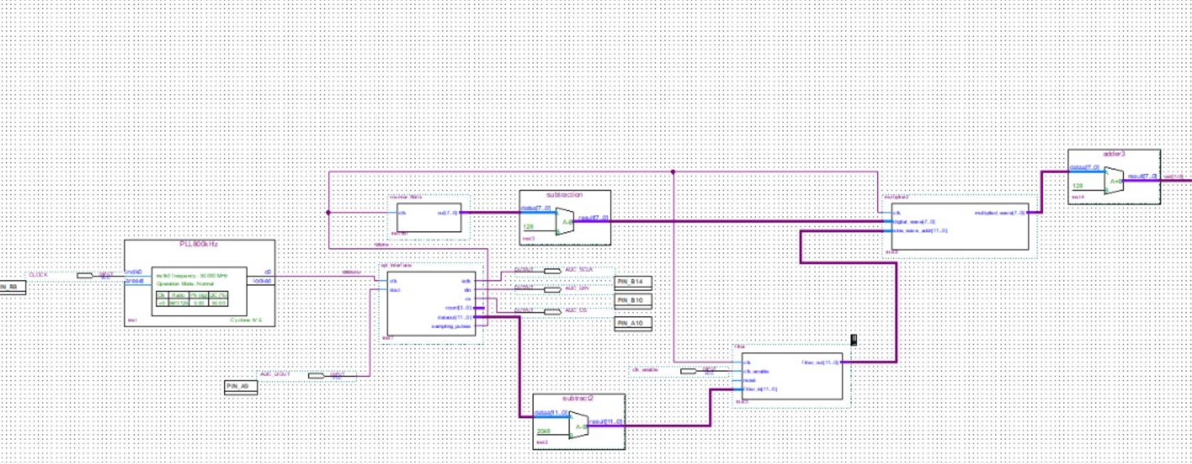
Components involved in the Audio Descrambler
Analogue-to-Digital Converter (ADC)
8kHz Digital Band-stop Filter
7 kHz sine wave
Digital-to-Analogue Converter (DAC)
5 kHz cutoff Low-pass Filter

Slide 3
ADC
Connect the analogue audio signal input to the ADC pins (which were specified in Quartus Prime) on the DE0 Nano FPGA board to interface ADC with the FPGA.
Develop a HDL code using Verilog.
Utilised SPI to interact with the ADC.
The DE0 Nano board functions only with digital signals. Includes advantages such as signal integrity since digital signals are less prone to noise and interference.
Summary: Efficient signal processing and compatible with digital nature of FPGA board.

Slide 4
8 kHz Band-stop Filter
The scrambled audio signal contained the highest power at 8 kHz. This was one of the scrambling methods which disallowed us to hear the audio message. To remove the 8 kHz tone, we designed and implemented an 8 kHz band-stop filter in “filterDesigner” in MATLAB.
We chose the Finite Impulse Response (FIR) band-stop filter because it offers greater stability, despite requiring more resources in the FPGA.
The digitised signal is then fed to the FIR band-stop filter.

Slide 5
7 kHz sine wave
The scrambled audio signal was flipped around 3.5 kHz. Multiplying the incoming digitised signal with a 7 kHz sine wave, in the time domain, will cause convolution in the frequency domain.
In the time domain this process is called Amplitude Modulating (AM). In the frequency domain it will include the sum and difference of the carrier (sine wave) and audio signal frequencies, therefore, resulting in sidebands. The upper sideband is located at the sum of the frequencies (7 kHz + frequencies of the flipped audio signal). The flipped audio signal from frequencies <3.5 kHz is shifted to frequencies >3.5 kHz. The upper sideband signal is removed by inputting the signal to an external low-pass filter.

Slide 6
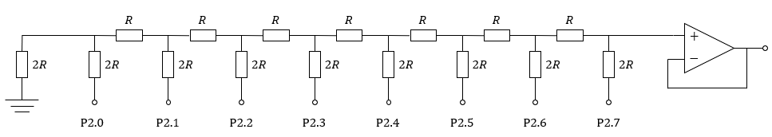
DAC
Before inputting the signal to a low-pass filter the digitised, modulated signal is converted back to an analogue signal. The signal is required to be in analogue form to apply a low-pass filter to it. The DAC used was a R-2R Ladder DAC.
The output pins assigned from Quartus Prime to the FPGA board are inputted into the R-2R Ladder.
The ladder is connected to the passive non-inverting input of the op-amp.
If there is anything wrong with the op-amp and the output hits the 15 V limit. However, the digital pins of the FPGA are not damaged with this configuration, since this voltage would have been fed back to them. This is because we use an op-amp voltage buffer which limits the output voltage from reaching 15 V.

Slide 7
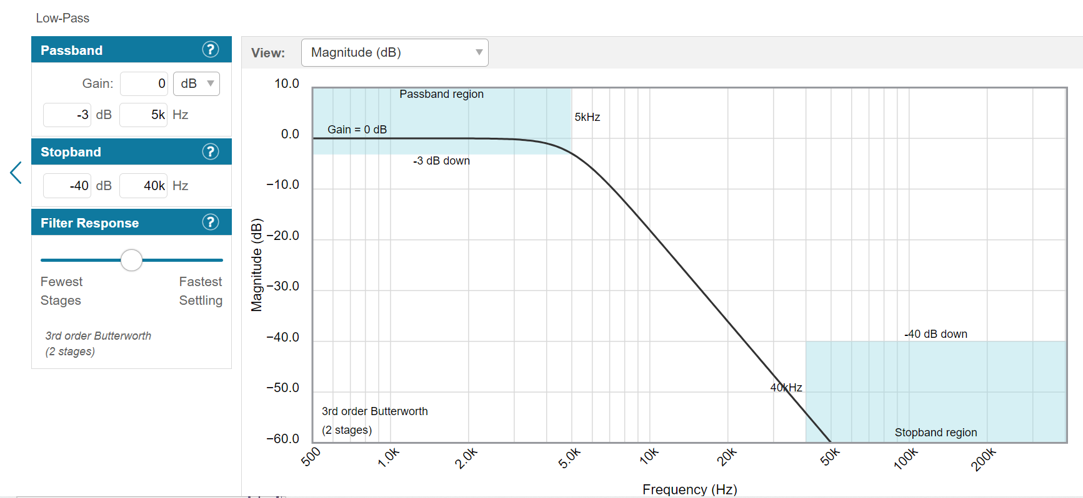
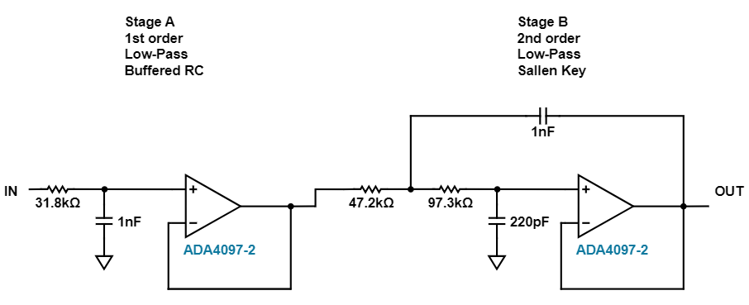
5 kHz Low-pass Filter
The low-pass filter was designed by using an online active filter design tool. (http://www.analog.com/designtools/en/filterwizard/)
We specified the necessary characteristics of the filter, to have the cut-off frequency at approximately 5 kHz to attenuate the upper sideband signal which was created by the sine wave modulation. To improve the attenuation the slope must be greater. However, this would require more cascaded amplifiers which would require more breadboard space.

